Slide 1
Food Label Lingo Understanding Food Labels

Slide 2
Food Label Lingo
Come and learn how to identify and understand the different parts of a food label.
The resources and actionable tips gained will help you speak food label lingo and empower you to make nutritious decisions that will lead to lifelong healthy eating habits.
Notes:
Read through slides with participants

Slide 3
Goals for today!
I can identify what a food label is
I can identify the parts/components of a food label
I understand all the parts/components of the food label
I can identify, explain and demonstrate how I would use food labels at home and in everyday food situations.
Notes:
Read through the “Goals” with the participants

Slide 4
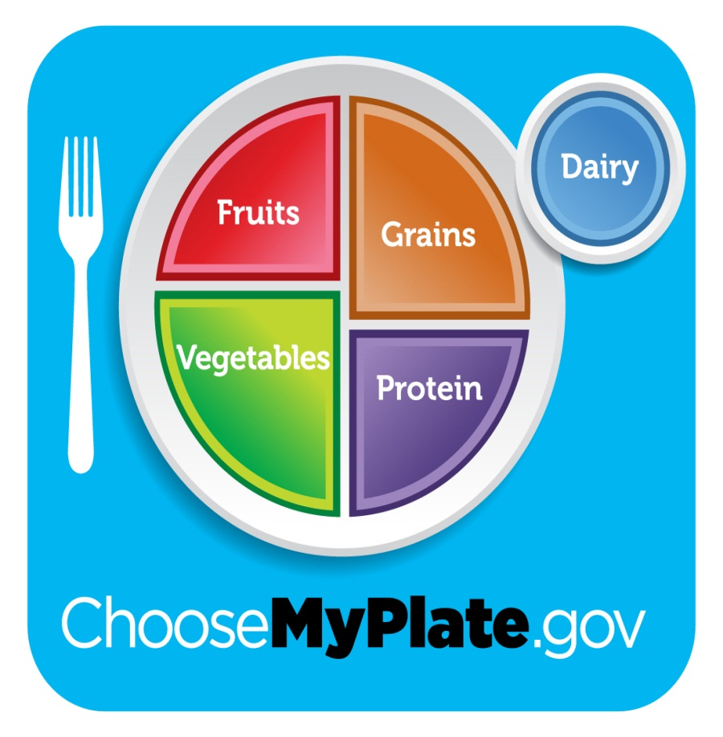
Eating Nutritious: Choose My Plate
Eat colorful
Incorporate all
food groups in
your diet
Notes:
Key Points:
If a person eats “colorful” or eats all the colors of the rainbow the more likely they are to eat all the food groups.
People are often lacking fruits and vegetables. If they eat more colors (colorful) they are more likely to increase their fruit and vegetable consumption.

Slide 5
Did you?
Read a food label already today?
Eat something today with a food label on it?
How easy is it to determine a serving size?
Notes:
Gets them to recognize that food labels are on many products
Labels do require people to have a little background knowledge on what it all means
Gets the participants thinking about their food choices
Cover with participants that fresh foods (fruits and vegetables) do not have a label
Any food item made homemade will not have a label so portion control is important

Slide 6
Food Label Icebreaker
Using the food product on the table
First glance is this a “healthy” choice for a snack?
Measure out how much you normally would eat
Guess what the serving size would be
Notes:
Have popcorn available for participants to put in a cup or on a napkin

Slide 7
Nutritious Value of Popcorn
Serving Size: 1 cup popped
20 calories
0g fat (in popped)
28g carbohydrates
5g of dietary fiber
4g of protein
What do we add to popcorn that makes this a less nutritious snack?
Notes:
This value is for air popped popcorn
Values may be altered slightly based upon the brand that is used

Slide 8
What is a food label?
It is a resource found on packaged foods containing nutritional facts about the food item
Not all food items have food labels
Do we know some examples?
Notes:
No Nutrition Labels:
Fresh fruits and vegetables
Protein products (ground beef, pork chops)
Deli items
Restaurant food items

Slide 9
How do I read a food label?
Identify each part of the food label
Understand each of the parts
What do they mean?
What are the numbers?
How does this label fit within my everyday nutritious eating?
Notes:
Next slides will break down what each part of the food label
Give guidelines of how to read and what the numbers mean
Deciding if the food item is a good choice or fits into your daily diet

Slide 10
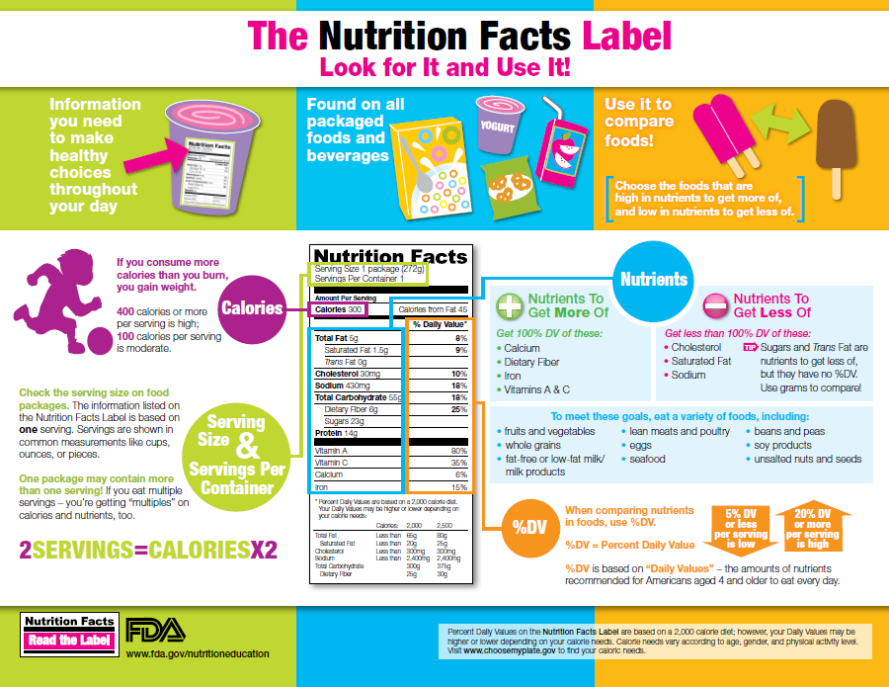
Let’s Take a Look
Notes:
Hand out which gives good guidelines and is a visual for all the sections we will be discussing

Slide 11
Notes:
Have the participants use the “The Nutrition Facts Label; Look for it and Use It” from the FDA
The handout will pull out each section and have the same messaging

Slide 12
Notes:
Have the participants use the “The Nutrition Facts Label; Look for it and Use It” from the FDA
The handout will pull out each section and have the same messaging

Slide 13
Notes:
Have the participants use the “The Nutrition Facts Label; Look for it and Use It” from the FDA
The handout will pull out each section and have the same messaging

Slide 14
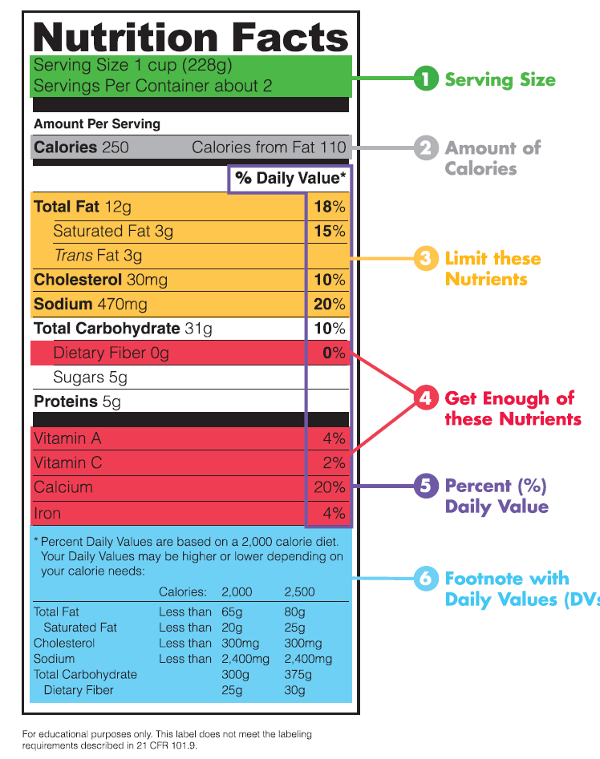
Parts of a Food Label
Notes:
Use the “Food Label Lingo” handout
Participants can use this handout to make notes from the next 2 slides

Slide 15
What does each part mean?
Serving Size
Helps with portion control
Amount of calories
Keeping track of calories will help you manage your weight
The amount of calories you eat should balance how many calories you are using
Notes:
Participants may want to write down some of the messaging
Being aware and only eating the “serving size” will control the amount of calories, fat, etc.
Serving sizes help people control their portions which over time could lead to weight loss
Based upon age, weight, height and doctor recommendations a person can set a calorie limit for each day
The average calorie limit is between 2000 and 2500 calories each day
Input of calories should balance output of calories (exercise)
Having a high input and low output will lead to weight gain
Having a low input and high output will lead to weight loss
Key Point: Find a healthy balance between input and output. Follow recommendation of doctor

Slide 16
What does each part mean?
Limit these nutrients
We often eat too much of these nutrients. Limit the amount. Stay below the Daily Value listed on bottom of label
Get enough of these nutrients
We often don’t consume enough of these nutrients. Be sure to include them in your daily diet
Percent (%) daily value:
This percent will tell you how much it will contribute to your TOTAL daily diet
Quick Guide 5% of DV or less is low and 20% or more is high
Notes:
Participants may want to write down some of the messaging
Nutrients in yellow are the nutrients you want to limit.
These nutrients may lead to other health related issues (high cholesterol, heart disease)
Nutrients in red are the nutrients people tend to lack.
Dietary fiber is important to maintain proper digestion. Vitamins and minerals have many functions within the body.
Read through the Quick Guide of % of daily value

Slide 17
Ingredients on the Food Label
Identify if the food is nutritious
Look for Nutritious foods listed first
Examples: Whole Wheat Flour, tomatoes, corn, beef, chicken
Try to limit the amount of additives and preservatives
No additives or preservatives listed first
Examples: Salt, sugar, MSG, artificial colors
Notes:
Ingredients are listed by quantity.
Ingredient listed first is the “most”
Ingredients listed last is the “least”
Ingredients that are long and hard to pronounce are usually additives/preservatives. Eat foods with not a lot of additives and preservatives.

Slide 18
How can I use in everyday food situations?
Portion control
Follow serving sizes listed and only eat that amount
Example: ½ cup cereal. Measure out ½ cup instead of pouring a “bowl full”
Total calorie intake
How many calories are you eating each day?
Ingredients
Identifying the better “nutrition” option
At store compare the two products
Compare nutrition values and ingredients
Notes:
Review the handout
All material has been covered

Slide 19
What can the food label do for you?
Assists with overall control of portion sizes
Assists with receiving all the food groups and receiving adequate nutrients
Identify quality nutritious products
Children
Role model “positive” eating habits
Combat obesity
Ages 9-13 is when they start making food decisions
Notes:
Read through slide

Slide 20
Nutritious Meals
“When Packing a Lunch”
“Shaking Down Sodium”
“When Choosing Snacks”
Handouts are phrased for “kids”
Information is valuable for adults
Notes:
Read through the handouts.
Tips on the side have valuable information of what participants can do at home.

Slide 21
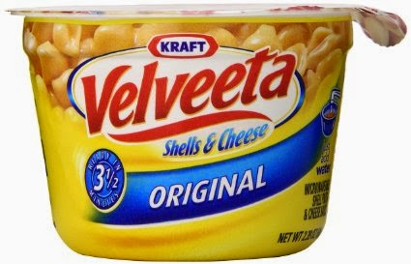
What do the dates mean on foods?
Best Buy Dates
Lose quality over time
The food is at its best before the date
Expiration Dates
Food loses quality
Change in appearance and texture
Examples: Dairy products and meat products
Notes:
Best Buy Dates:
Foods have been tested to maintain their quality until that date.
Foods will lose quality after that date
Expiration Dates:
Change in appearance will be obvious
If you “in doubt throw it out”

Slide 22
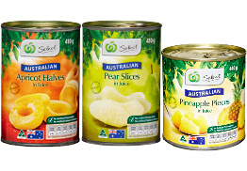
Food Safety of Products
Food labels are on all “packaged” products
Look for
Dents
Open packaging
Current Dates
Notes:
Purchasing and Eating safe and quality food is essential for maintain proper health and wellness

Slide 23
Speaking Food Label Lingo
Labels are one resource to help you
Choose and eat more nutritious foods
Control your portion control
Remember parts when
In grocery store
At home
Out to eat
Notes:
Read through slide

Slide 24
Check out
www.fda.gov/nutritioneducation
For more information on Food Labels
Resources for parents and kids
Notes:
Website provides more information about food labels and labeling of food products.

Slide 25
Questions?

Slide 26
UW-Extension Family Living
To find out more information about Family Living
www.facebook.com/UWExtensionFamilyLiving
http://flp.ces.uwex.edu/
Food Label Lingo materials developed by Sarah Siegel, Family Living Educator, Wood County UW-Extension , 2015
University of Wisconsin, U. S. Department of Agriculture and Wisconsin counties cooperating. An EEO Affirmative Action employer, the University of Wisconsin - Extension provides equal opportunities in employment and programming including Title IX and American with Disabilities (ADA) requirements.

