Slide 1
Understanding Cancer Basics
Notes:
Understanding Cancer Basics is part of the “Cancer Clear & Simple” program. This program provides cancer education in regards to basics, prevention, and screening; it is a collaboration between the UW Carbone Cancer Center and UW Cooperative Extension. It’s goal is to decrease the cancer disparities that is experienced in rural Wisconsin.

Slide 2
Understanding Cancer Basics
Can cancer be prevented?
What is cancer?
How is cancer diagnosed?
What does cancer stage mean? Why is it important?
What are cancer risk factors?
How does cancer spread?
Notes:
In Understanding Cancer Basics we will answer these questions (read questions). Please remember that this information is taught to help you understand the basics. It is not meant to take the place of information given by your health care provider. Also, as a trainer, I am not the cancer expert! I am here to provide basic information.

Slide 3
Today’s Objectives
At the end of this section, you will be able to:
UNDERSTAND what cancer is
STATE how a cancer diagnosis is made
IDENTIFY cancer risk factors
UNDERSTAND the importance of cancer stage
Notes:
(Read slide)

Slide 4
What is Cancer?
Cancer is not just one disease, but a group of over 200 different diseases.
Cancer is an abnormal growth of cells.
Each cell contains a set of instructions (DNA).
The instructions tell the cell when to reproduce and when to die.
Sometimes, the instructions (DNA) can be damaged and can result in a mutation.
If cells keep reproducing in an uncontrolled way, a mass forms.
Notes:
Read slide.

Slide 5
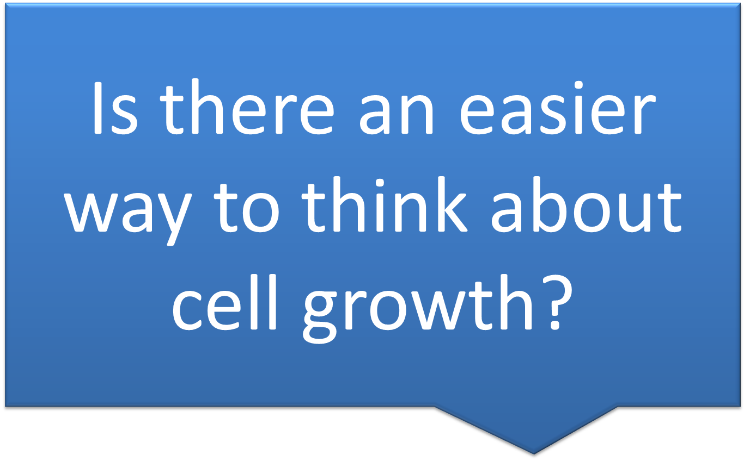

Slide 6
Normal Cell Growth
Normally your body tells itself to stay on cell cruise control.
Cell cruise control maintains a steady, orderly speed and always stays in its lane.
Notes:
Read slide.

Slide 7
Uncontrolled Cell Growth
If the cruise control instructions are damaged, the cell growth gas pedal can get stuck in acceleration mode.
Constant acceleration mode means that cells are reproducing at a much faster rate than necessary.
This equals higher speeds and more cells.
If cells are going too fast in traffic, a pile up can happen.
This cell pile up is called a tumor.
Notes:
Read slide. The “Abnormal Cell Growth” Activity will follow this slide.

Slide 8
Tumors can be benign or malignant
Benign tumors are not cancer. They do not spread to other parts of the body and are not usually a threat to someone’s life.
Malignant tumors are cancer cells which reproduce without control or order. Cancer cells can spread to other parts of the body. Think of the cells like a car whose cruise control is stuck and speeding out of control.
Notes:
Read slide

Slide 9
What causes cancer?
Over time, a cell takes many “hits.”
“Hits” come from:
what you are exposed to (environmentally, occupationally, radiation, viruses), and
how you live (tobacco, diet, alcohol, activity, etc.)
Notes:
Complete “Abnormal Cell Growth Activity” after this slide. Read the activity (see handout).

Slide 10
National Cancer Risk Factors

Slide 11
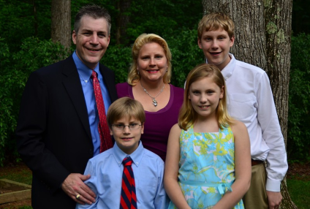
Individual Cancer Risk Factors
Family history, gender or age can also influence a person’s risk for developing cancer.

Slide 12
What are my cancer risk factors?
Your risk of developing cancer, as well as stroke, heart disease and diabetes, depends on:
who you are (family history)
what you are exposed to (environmentally, secondhand smoke, occupationally, viruses, radiation), and
how you live (tobacco, diet, alcohol, physical activity, etc.).
Notes:
RJL

Slide 13
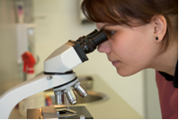
How is a cancer diagnosis made?
A cancer diagnosis can only be made by looking at cells from a biopsy under a microscope.

Slide 14
Primary Cancer Site
Most cancers are identified by the organ in which they first begin to grow (i.e. breast cancer).

Slide 15
What if the cancer spreads?

Slide 16
Example: The Stages of Colorectal Cancer

Slide 17
Thank you!! For additional information please contact www.ruralcancernetwork.org website.

